Slide 1
K-SVD Denoising Algorithm using Sparse and Redundant Dictionary Learning
Presenters:
Shreeya Garg(22555)
Aditya Banerjee(22455)

Slide 2
CONTENTS
Problem Description
Methodology
Sparse Coding
Orthogonal Matching Pursuit
Dictionary Learning
Results
Analysis

Slide 3
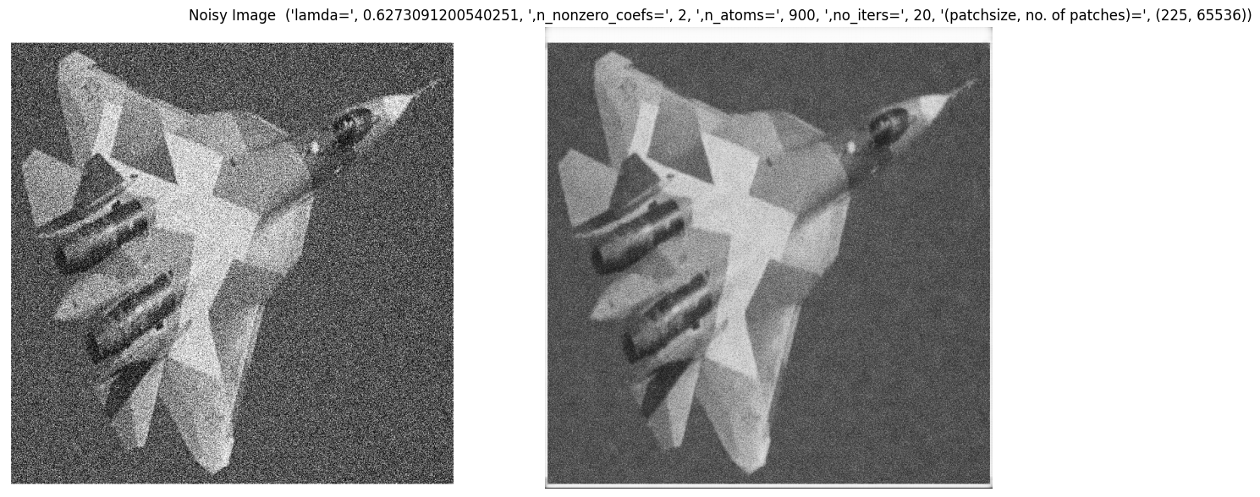
PROBLEM DESCRIPTION
Image denoising is a critical task in computer vision and image processing with applications ranging from medical image analysis to surveillance systems.
The presented project aims at denoising the images using KSVD algorithm and optimize its performance by tuning different parameter.
Denoising Algorithm

Slide 4
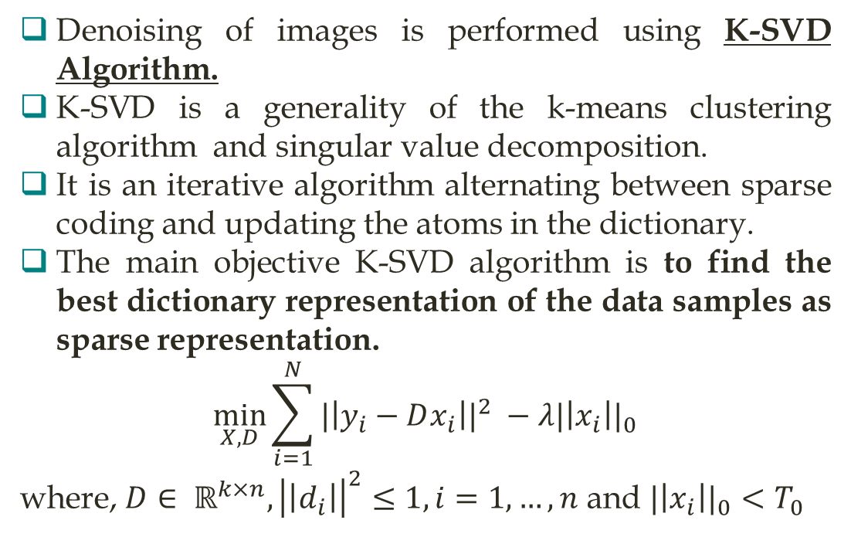
METHODOLOGY
Input Image
Dictionary Initialization
Denoising of images is performed using K-SVD Algorithm.
K-SVD is a generality of the k-means clustering algorithm and singular value decomposition.
It is an iterative algorithm alternating between sparse coding and updating the atoms in the dictionary.
The main objective K-SVD algorithm is to find the best dictionary representation of the data samples as sparse representation.
$$\min_{X,D}{\sum_{i=1}^{N}{{|\left|y_{i}−Dx_{i}\right||}^{2} −λ{|\left|x_{i}\right||}_{0}}}$$
where, $D∈ ℝ^{k×n}, {\left|\left|d_{i}\right|\right|}^{2}≤1, i=1,…, n$ and ${|\left|x_{i}\right||}_{0}<T_{0}$
Sparse Coding
Dictionary Learning
Stopping Criteria
NO
YES
END

Slide 5
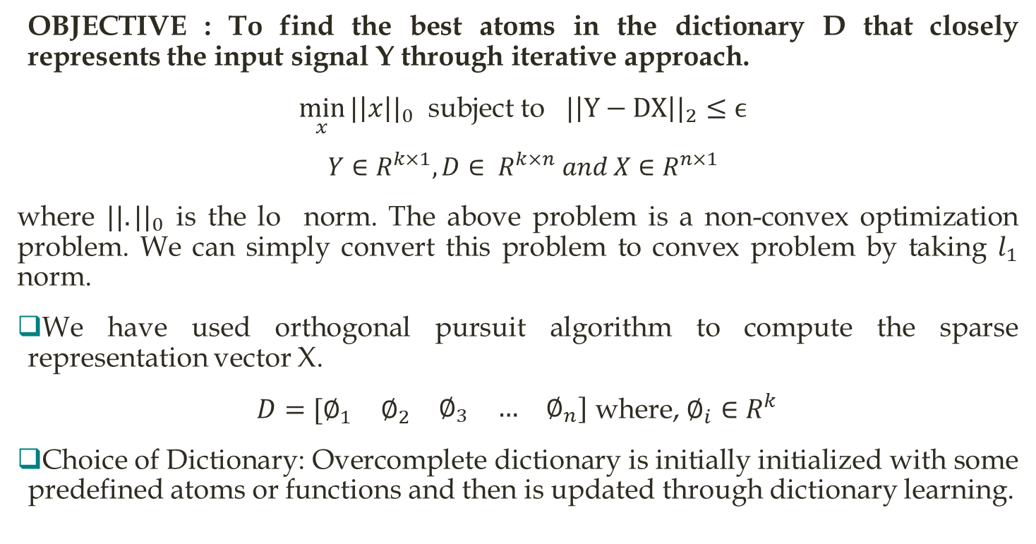
SPARSE CODING
OBJECTIVE : To find the best atoms in the dictionary D that closely represents the input signal Y through iterative approach.
$\min_{x}{{|\left|x\right||}_{0}}$ subject to ${|\left|Y−DX\right||}_{2}≤ϵ$
$Y∈R^{k×1}, D∈ R^{k×n} and X∈R^{n×1}$
where ${||.||}_{0}$ is the lo norm. The above problem is a non-convex optimization problem. We can simply convert this problem to convex problem by taking $l_{1}$ norm.
We have used orthogonal pursuit algorithm to compute the sparse representation vector X.
$D=[\begin{matrix}∅_{1} & ∅_{2} & \begin{matrix}∅_{3} & … & ∅_{n}]\end{matrix}\end{matrix}$ where, $∅_{i}∈R^{k}$
Choice of Dictionary: Overcomplete dictionary is initially initialized with some predefined atoms or functions and then is updated through dictionary learning.

Slide 6
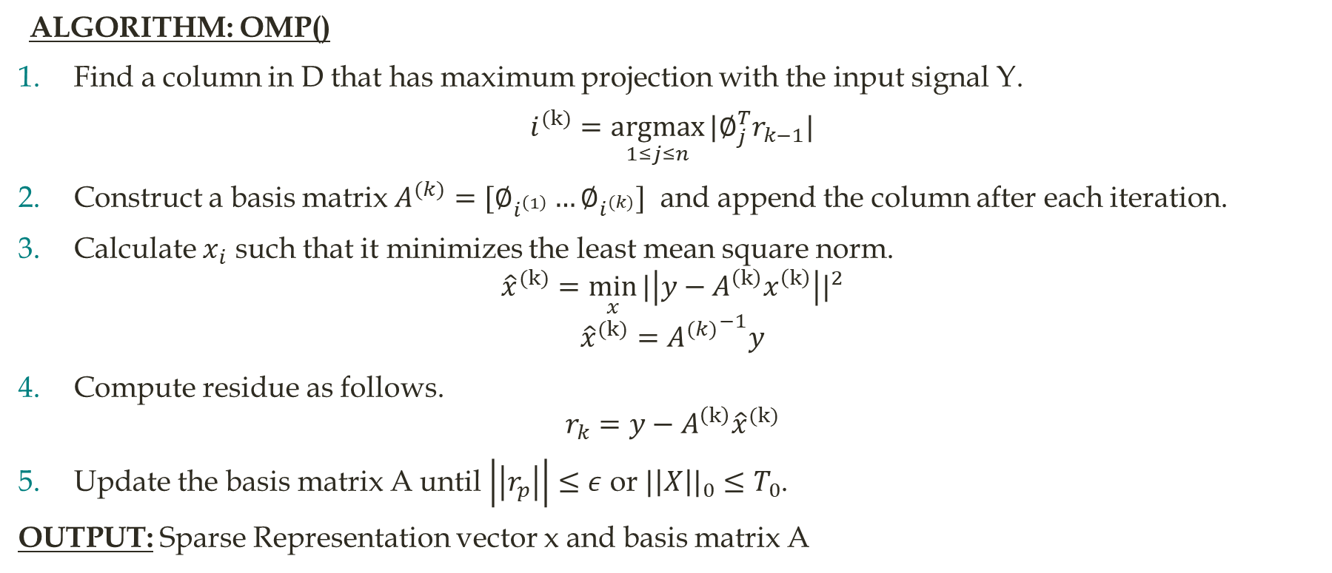
ORTHOGONAL MATCHING PURSUIT
ALGORITHM: OMP()
Find a column in D that has maximum projection with the input signal Y.
$i^{(k)}=\underset{1≤j≤n}{argmax}{|∅_{j}^{T}r_{k−1}|}$
Construct a basis matrix $A^{(k)}=[∅_{i^{\left(1\right)}}…∅_{i^{(k)}}]$ and append the column after each iteration.
Calculate $x_{i}$ such that it minimizes the least mean square norm.
$${\hat{x}}^{(k)}=\min_{x}{{|\left|y−A^{\left(k\right)}x^{\left(k\right)}\right||}^{2}}$$
$${\hat{x}}^{(k)}={A^{(k)}}^{−1}y$$
Compute residue as follows.
$$r_{k}=y−A^{\left(k\right)}{\hat{x}}^{(k)}$$
Update the basis matrix A until $\left|\left|r_{p}\right|\right|≤ε$ or ${|\left|X\right||}_{0}≤T_{0}$.
OUTPUT: Sparse Representation vector x and basis matrix A

Slide 7
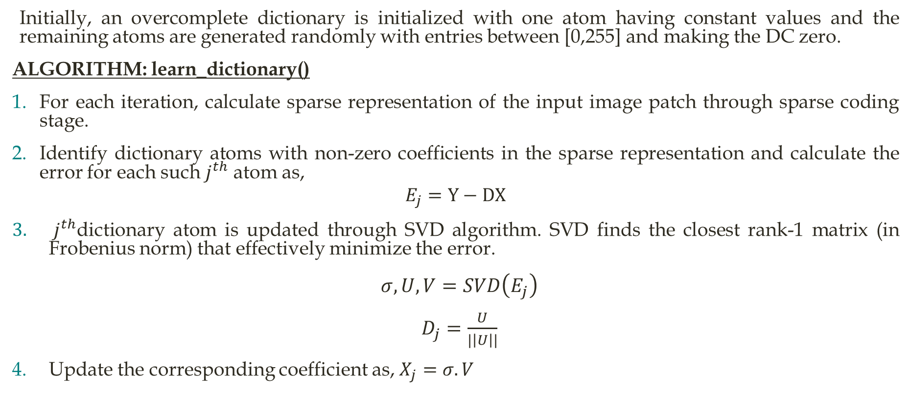
DICTIONARY LEARNING
Initially, an overcomplete dictionary is initialized with one atom having constant values and the remaining atoms are generated randomly with entries between [0,255] and making the DC zero.
ALGORITHM: learn_dictionary()
For each iteration, calculate sparse representation of the input image patch through sparse coding stage.
Identify dictionary atoms with non-zero coefficients in the sparse representation and calculate the error for each such $j^{th}$ atom as,
$$E_{j}=Y−DX$$
$j^{th}$dictionary atom is updated through SVD algorithm. SVD finds the closest rank-1 matrix (in Frobenius norm) that effectively minimize the error.
$σ, U,V=SVD\left(E_{j}\right)$
$D_{j}=\frac{U}{|\left|U\right||}$
Update the corresponding coefficient as, $X_{j}=σ.V$

Slide 8
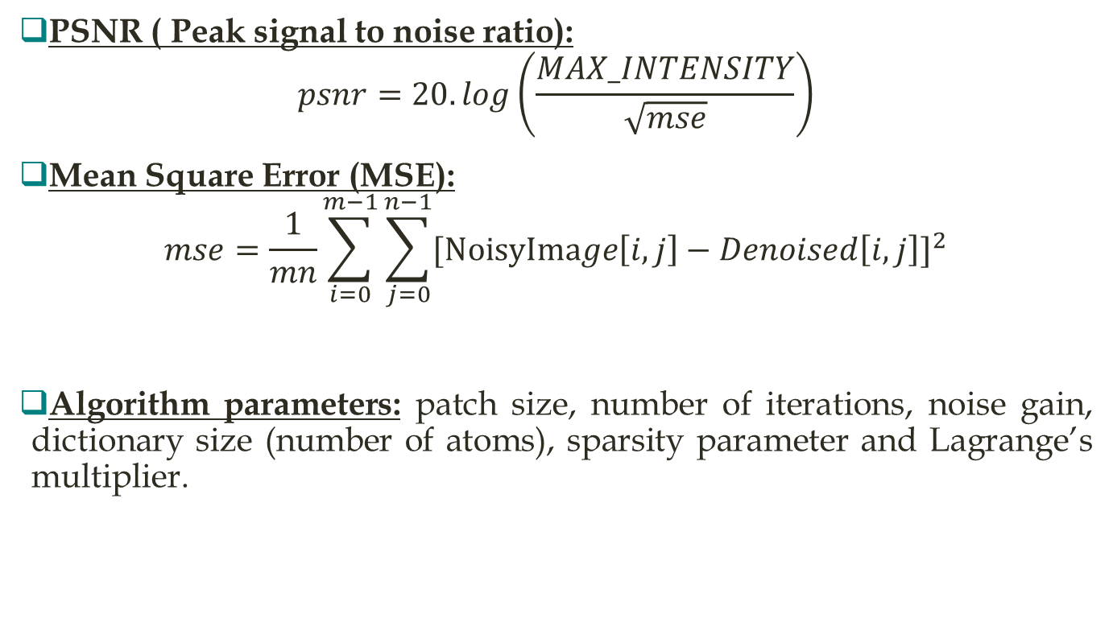
RESULTS
PSNR ( Peak signal to noise ratio):
$$psnr=20.log\left(\frac{MAX_INTENSITY}{\sqrt{mse}}\right)$$
Mean Square Error (MSE):
$$mse=\frac{1}{mn}\sum_{i=0}^{m−1}{\sum_{j=0}^{n−1}{{[NoisyImage\left[i,j\right]−Denoised\left[i,j\right]]}^{2}}}$$
Algorithm parameters: patch size, number of iterations, noise gain, dictionary size (number of atoms), sparsity parameter and Lagrange’s multiplier.

Slide 9
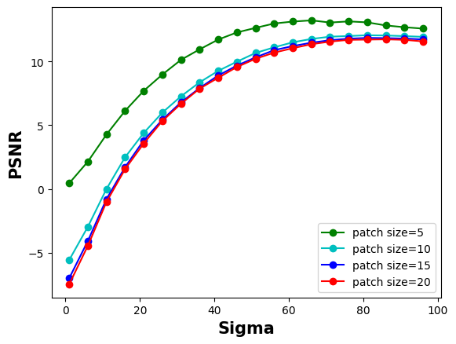
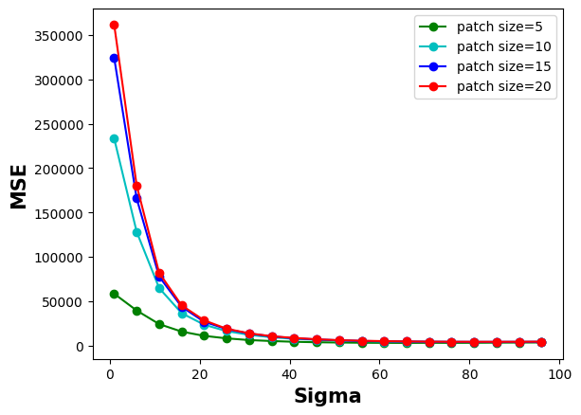
Analysis
Taking smaller patches of the images leads to bad reconstructed images due to lack of overlapping. Hence denoising is not proper.
As the number of iterations increases, PSNR decreases leading to good denoised image.
For higher noise images, algorithm performs better with higher patch size and number of iterations. But also blurs the image to the extent that edge detection becomes difficult.
Higher MSE and low PSNR is observed for highly denoised images as shown in the adjacent figures.

Slide 10
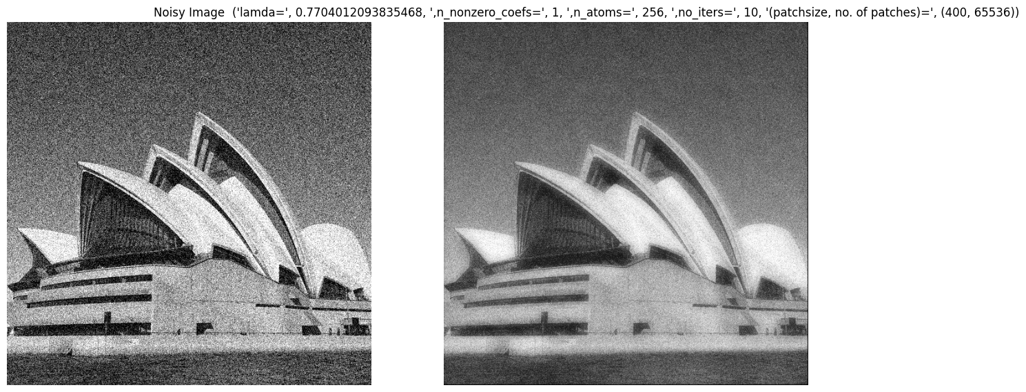

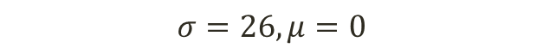
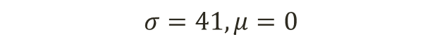
Image Denoising through KSVD algorithm when gaussian noise is added artificially.
$$σ=26, μ=0$$
$$σ=41, μ=0$$

Slide 11
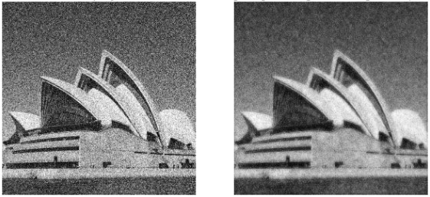
Some results
Test image processed through KSVD Algorithm (Parameters: No. of atoms=256, Noise=61.36 Patch size=10x10, sparcity=1, number of iterations=10.)
PSNR= 10.37
MSE= 5971.44

Slide 12
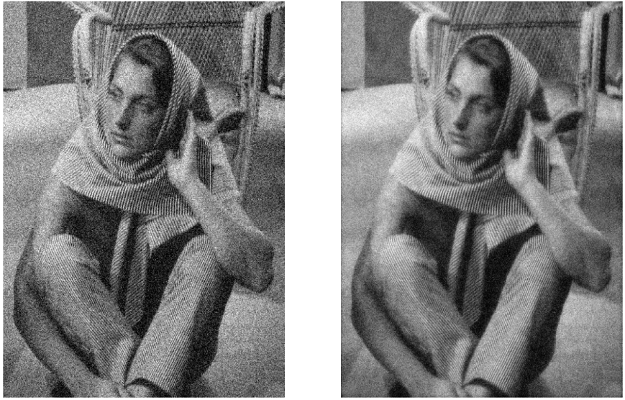

Slide 13
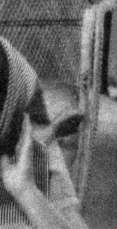
Noise is visible in the restored as it is combined with the noisy image.
This restored image can be further denoised by feeding it back to the algorithm.
Next slide shows the restored image without mixing in the original image

Slide 14
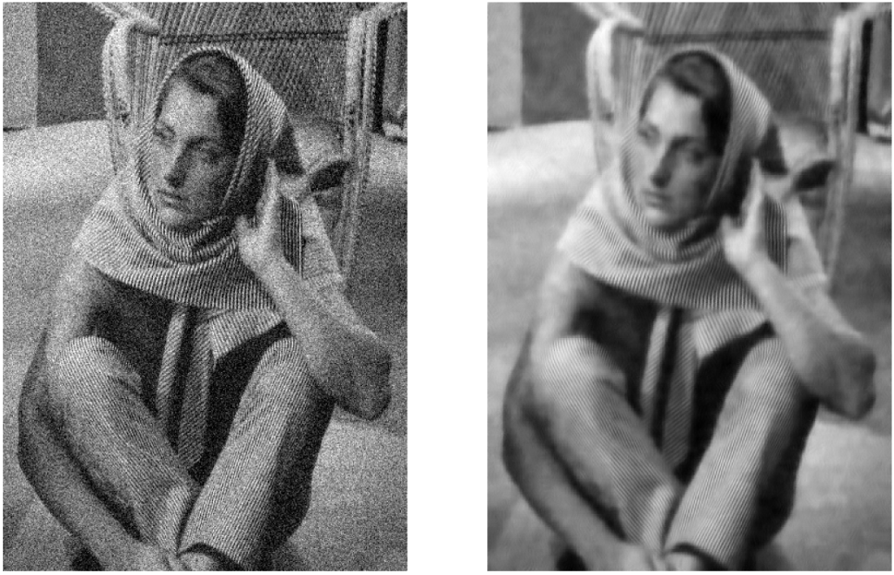

Slide 15
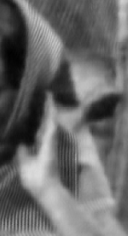
Observe that the portion of the image with pixels arranged in straight line are very well represented.
There is a blurring effect in the restored image, and some portions are well represented while others have their details not clearly visible.

Slide 16
THANK YOU

